Slide 2

NIEM - OASIS Open Project Keeping pace with innovations in Data Technologies and Standardization
Stuart Whitehead
Katherine Escobar
Department of Defense

Slide 3
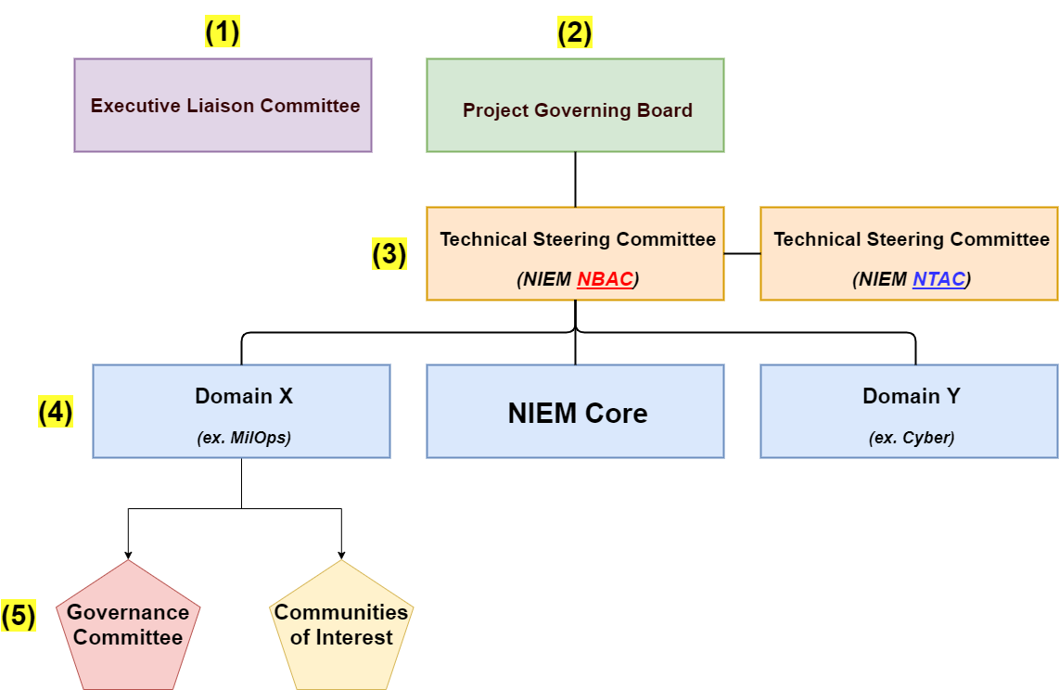
Proposed NIEM Move to OASIS
Becomes: an OASIS “Open Project”
Why the Move: it’s the next logical NIEM maturity step and allows NIEM to be designated a standard. This move shifts leadership and resourcing to the OASIS user community.
NIEM “As Is” “To Be”
NIEM ESC – becomes Executive Liaison Committee
NIEM Management Office – becomes Project Governing Board
NIEM Technical and Business Architecture Committees – becomes Technical Steering Committees
NIEM Domain Stewards – no change
Tiger Teams – no change
Lead Developer – funded by OASIS and Project Governing Board
NIEM Core Steward – OASIS Technical Steering Committees
Selected Membership Considerations
Federal CDO Council co-chairs invited to be a member of Executive Liaison Committee
DoD CDO invited to be a member of Executive Liaison Committee
Domains invited to be a member of the Project Governing Board
Joint Staff J6 member of the Project Governing Board
Joint Staff J6 retains MilOps Doman stewardship
International participation encouraged at all levels

Slide 4
Proposed NIEM Transition
12 Month Transition Plan
Sep 21: NBAC and NTAC endorsement
Sep 21: NIEM ESC transition approval / OASIS acceptance
Oct 21: NIEM Transition Kickoff (JS J6 $25K commitment)
Dec 21: Charter and governance construct approved by ESC / OASIS
Jan 22: Awareness marketing campaign
Feb 22: Domain Stewards transition workshop
Mar 22: Project Governance Board Sponsors solicited
Apr 22: OASIS NIEM Committees membership codified
Jul 22: Shadow OASIS governance in place
Aug 22: Selected NIEM projects transition
Sep 22: Last NIEM ESC and NIEM face-to-face
Sep 22: NIEM shifts to OASIS governance
Sep 22: NIEM ESC, NTAC, NBAC, & NMO stand down
Oct 22: Transition complete marketing campaign
NIEM Major Projects Transition
Annual Model update – to OASIS
Meeting Management – to OASIS
Training – to OASIS
Marketing – to OASIS
Enterprise Tools – to OASIS
Open IEPD Repository – to OASIS
Restricted (CUI) Repository – to MilOps Domain
NIEM.gov website – retained by JS J6 and DHS
Participant Steady State
Resources
Domain Stewardship
Technical Steering Committee member
Project Governance Board (PGB) sponsor – $25K
SES participation in the PGB sessions

Slide 5
Backup Slides

Slide 6
NIEM OASIS Potential Sponsors
Non-Government/Commercial
GTRI
NASCIO
MITRE
Cybercrime Support Network
IBM (SPARKS)
IJIS
OMG
COMPTIA
Grid-ML
Nishkarsh
Magic Drawcrossflo
State/Local Governments
State Courts
Domain Stewards (15 and counting)
Joint Staff (MILOPS)
DHS (CISA, Biometrics, Immigration)
Veterans Affairs
Advanced Distributed Learning
NIST
DOJ
DCSA
CDC
International
Canada (Public Safety, Employment & Social Development)
Mexico
Interpol (EUROJUST)

Slide 7
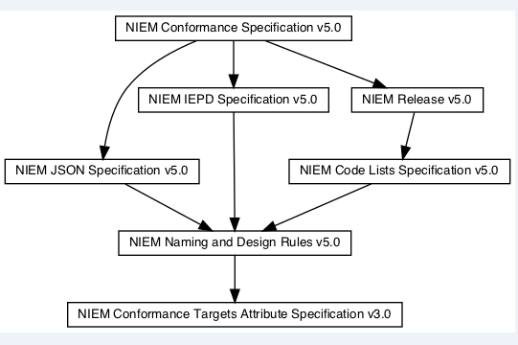
Specifications included in the Niem standard
The NIEM standard includes the data model and a collection of specifications that work together to support what we refer to as NIEM
NIEM Conformance Specification
NIEM Data Model/ NIEM Release v5.0
NIEM IEPD Specification v5.0
NIEM JSON Specification v5.0
NIEM Code Lists Specification v5.0
NIEM Naming and Design Rules (NDR) v5.0
NIEM Conformance Targets Attribute Specification v3.0
*An arrow represents a dependency of one item upon another

Slide 8
Recommendation
Establish NIEM as an Open Standard through OASIS
Base Sponsor dues ($25k) cover the core technical, legal, promotional, and administrative services provided by OASIS
Path to ratified National and International standard status
12-24 month timeline to standard ratification

Slide 9
Existing Standards that include NIEM
ANSI 42.42 Radiological Nuclear detectors
ANSI APCO Alarm Monitoring Company to Public Safety Answering Point (PSAP)
OASIS EXDL FEMA
NIST Big Data Framework Vol 7
Nation Fire Protection NFPA 950 calls for compliance with NIEM. Emergency Incident Data Document (EIDD) IEPD – NISTIR 8255
Biometrics ANSI/NIST ITL Standard
Biometric Conformance Test Software (BioCTS)
BioCTS for AN-ITL v2 is a desktop application which tests electronic biometric data files, known as transactions, for conformance to NIST Special Publication (SP) 500-290
Conformance Test Architecture (CTA) and Test Suite (CTS) called "BioCTS for AN-2011 NIEM XML" designed to test implementations of AN-2011 NIEM XML encoded transactions.
NIEM Cited in patent – Integrated Environment for Developing Information Exchanges patent No: US 8,769,480 B1 Dated July 1, 2014
Model Minimum Uniform Crash Criteria Guideline (MMUCC) – Department of Transportation

Slide 10
Reasons for NIEM an Open Source standard
Aligns with the Law mandating the use of voluntary consensus standards over government developed standards:
National Technology Transfer and Advancement Act of 1995 (NTTAA), Public Law 104-113
Government at every level favors standards - OMB 119
Align with NIST the government cited assessment body for compliance of systems
Government and Industry favors formal standards
Inherent Interoperability due to rigor in vetting standards
Increases awareness of NIEM to larger audience
NIEM already meets most of the criteria for becoming a standard
Increased visibility, contribution, and use by open source tool developers
Compliance argument over competing government developed standards
Notes:
National Technology Transfer and Advancement Act of 1995 (NTTAA), Public Law 104-113 requires all federal government agencies to use, wherever feasible, standards developed or adopted by voluntary consensus standards bodies in lieu of developing government-unique standards or regulations
OMB 119 maintains a strong preference for using voluntary consensus standards over government to unique standards in Federal regulation and procurement
NIEM included in other standards
ANSI 42.42 Radiological Nuclear detectors
ANSI APCO Alarm Monitoring Company to Public Safety Answering Point (PSAP)
OASIS EXDL FEMA
NIST Big Data Framework Vol 7
Nation Fire Protection NFPA 950 calls for compliance with NIEM. Emergency Incident Data Document (EIDD) IEPD – NISTIR 8255
Biometrics ANSI/NIST ITL Standard
Biometric Conformance Test Software (BioCTS)
BioCTS for AN-ITL v2 is a desktop application which tests electronic biometric data files, known as transactions, for conformance to NIST Special Publication (SP) 500-290
Conformance Test Architecture (CTA) and Test Suite (CTS) called "BioCTS for AN-2011 NIEM XML" designed to test implementations of AN-2011 NIEM XML encoded transactions.
NIEM Cited in patent – Integrated Environment for Developing Information Exchanges patent No: US 8,769,480 B1 Dated July 1, 2014
Combination of Interoperability Registries with Process and Data Management tools for Governmental Services

Slide 11
IT’s The Law
National Technology Transfer and Advancement Act (NTTAA)
Section 12 of the National Technology Transfer and Advancement Act (NTTAA) of 1995 directs NIST to ‘‘coordinate technical standards activities and conformity assessment activities of Federal, State, and local governments with private sector technical standards activities and conformity assessment activities, with the goal of eliminating unnecessary duplication and complexity in the development and promulgation of conformity assessment requirements and measures’’ (15 U.S.C. 272(b)(13)).
The January 2016 revision to OMB Circular A–119 re-emphasizes NIST’s role in issuing guidance to agencies as well as Federal agencies responsibilities with respect to conformity assessment.
The National Technology Transfer and Advancement Act of 1995 (Public Law 104-113, 1996) (NTTAA) authorizes NIST to coordinate conformity assessment activities. The NTTAA states that NIST coordinates “Federal, State, and local technical standards activities and conformity assessment activities, with private sector technical standards activities and conformity assessment activities, with the goal of eliminating unnecessary duplication and complexity in the development and promulgation of conformity assessment requirements and measures.’’

Slide 12
Why sponsor an Open Project?
Organizations that sponsor an Open Project receive a seat on the Project Governing Board, where they:
Oversee the technical agenda and marketing activities.
Form a Technical Steering Committee and/or Marketing Group (optional).
Appoint Maintainers and elect Chairs.
Decide which work products to advance through standards process.
Request OASIS submission of approved work to ISO, IEC
Stand out on Project website, social media, events, press and analyst communications.
https://www.youtube.com/watch?v=McDnsOKUoxY

Slide 13
Why choose OASIS Open Standard
Freedom to create a portfolio of complementary materials under one organizational umbrella.
Option to advance appropriate deliverables through to OASIS Standard with the potential to be referenced by global SDOs including ISO, IEC, and ITU.
Industry-vetted IP policies and world-class legal support.
Clear rules to support strategic leadership and shared community development.
Experienced staff and seasoned programs to help your project reach its goals.

Slide 14
What will it cost?
Open Project Sponsorship Dues
Each Open Project is funded by annual Sponsor dues from organizations committed to its success.
Base Sponsor dues cover the core technical, legal, promotional, and administrative services provided by OASIS.
Base dues are determined by each organization’s total employee headcount.
$ 25,000: 2,000+ employees $ 15,000: 500-1,999 $ 10,000: 100-499 $ 5,000: 10-99 $ 2,000: <10 $ 1,000: Nonprofit, university, local or non-OECD government

Slide 15
What is an open Project
Open Projects is the first-of-its-kind program that creates a more transparent and collaborative future for open source and standards development.
Open Projects gives communities the power to develop what they choose--APIs, code, specifications, reference implementations, guidelines-- in one place, under open source licenses, with a path to recognition in global policy and procurement.
Engage open source community in distributed development while ensuring work stays on-track
Use vetted IP policy and open source licenses
Work under supported, streamlined process.
Submit work to ISO, IEC, ITU and/or EU for international recognition via PAS submitter status.
Focus on your technical goals while OASIS staff takes care of financial, legal, and technical administration and marketing
Leverage OASIS global reputation, 2000+ member base, and experience running standards and open source projects
Open Projects gives groups more control and streamlined governance. It provides all the process a community needs--and not a bit more--so groups can accomplish great things fast.

Slide 16
What Core Services Oasis provides
Legal entity, management of trademarks and copyrights
Contributor License Agreement administration
Collaboration tool set: GitHub org, mailing group, calendar, roster, ballot, asynchronous chat, video meetings…
OASIS Standards process submission management
Submission of approved deliverables to ISO, IEC, ITU via OASIS liaison
Community management support
Assistance in writing charter, Code of Conduct, other policies
Governance administration and support
Initial set-up of project assets such as website design, hosting, site maintenance, collateral and logo design
Press, promotion & outreach to attract developers and sponsors
Meeting planning and coordination
Free public access to deliverables in perpetuity

Slide 17
OASIS
OASIS
35 Corporate Drive Suite 150, Burlington, MA 01803-4238 USA
+1 781 425 5073
op-admin@oasis-open.org
https://www.oasis-open.org
https://github.com/oasis-open-projects/documentation
https://github.com/oasis-open-projects/documentation/blob/master/guides/getting-started-guide.md
https://github.com/oasis-open-projects/documentation/tree/master/guides

Slide 18
ANSI and Revised OMB Circular A-119
https://www.ansi.org/
https://anab.ansi.org/
https://www.federalregister.gov/documents/2016/01/27/2016-01606/revision-of-omb-circular-no-a-119-federal-participation-in-the-development-and-use-of-voluntary

